Slide 1
Building Responsive UI with Bootstrap
Jon Galloway | Technical Evangelist
Christopher Harrison | Content Developer

Slide 2

Meet Jon Galloway | @jongalloway
Azure Technical Evangelist
Focused on ASP.NET MVC
http://weblogs.asp.net/jongalloway
Web development on Microsoft platform since late '90s
Ex-submariner; Showcase Showdown winner “Price is Right”
Popular Author and Conference Speaker
Wrox Professional MVC 5; MVC Music Store tutorial
Virtual ASP.NET MVC Conference (mvcConf)
World wide Web Camps speaker
Herding Code podcast (http://herdingcode.com)

Slide 3

Meet Christopher Harrison | ‏@geektrainer
Content Developer
Focused on ASP.NET and Office 365 development
Microsoft Certified Trainer
Still misses his Commodore 64
Long time geek
Regular presenter at TechEd
Periodic blogger
Certification advocate
Marathoner, husband, father of one four legged child

Slide 4


Course Topics
Building Responsive UI with Bootstrap
01 | Introduction to Bootstrap | 05 | Bootstrap and JavaScript
02 | Bootstrap Components | 06 | Using Bootstrap with LESS
03 | Page Design | 07 | Bootstrap in the Real World
04 | Visual Studio and ASP.NET Integration | 08 | Supplement Your Knowledge

Slide 5
Setting Expectations
Target Audience
HTML/CSS developer
New to Bootstrap
Looking to fill knowledge gaps
Suggested Prerequisites/Supporting Material
Visual Studio 2013 Express for Web

Slide 6

Join the MVA Community!
Microsoft Virtual Academy
Free online learning tailored for IT Pros and Developers
Over 1M registered users
Up-to-date, relevant training on variety of Microsoft products
“Earn while you learn!”
Get 50 MVA Points for this event!
Visit http://aka.ms/MVA-Voucher
Enter this code: PowerJump1 (expires 8/15/2013)

Slide 7
01 | Introduction to Bootstrap
Jon Galloway | Technical Evangelist
Christopher Harrison | Content Developer

Slide 8
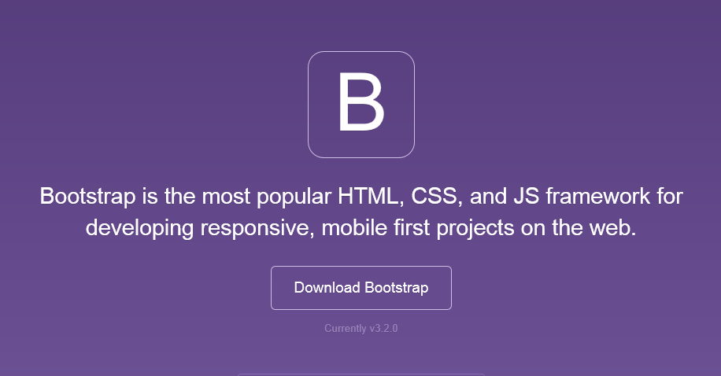
Bootstrap
The most popular front-end framework for developing responsive, mobile first projects on the web.

Slide 9
Why use it?
CSS is can be tricky
Cross browser support can be a challenge
Solves basic tasks (e.g. page layout without tables)
Bootstrap 3 makes it easier

Slide 10
Bootstrap Features
Theme Support
Responsive
Grid
Components
Pagination
Buttons
Modal
Great Visual Studio support

Slide 11
Bootstrap in ASP.NET Templates

Slide 12
Theme Support

Slide 13
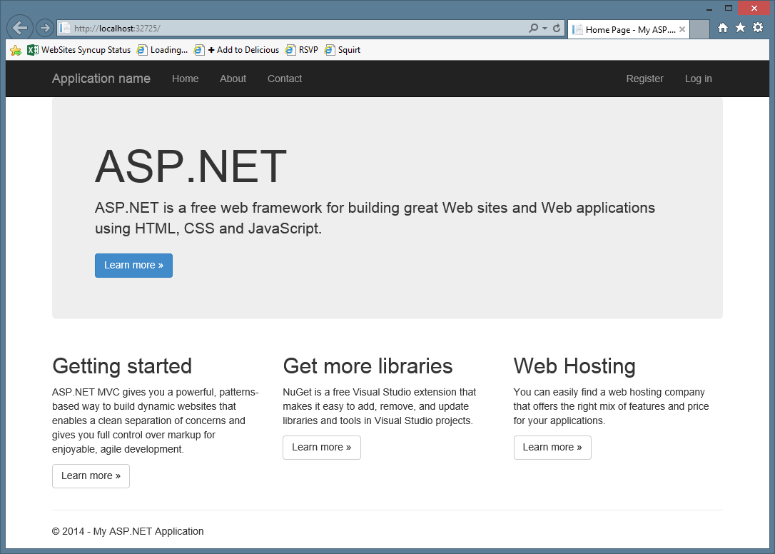

Slide 14
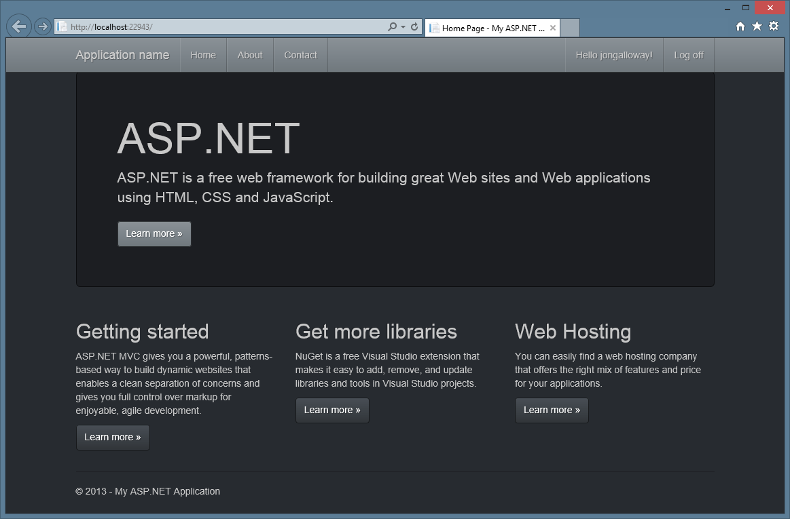

Slide 15
Bootstrap - Theme

Slide 16
Responsive Layout
Notes:
Bootswatch

Slide 17
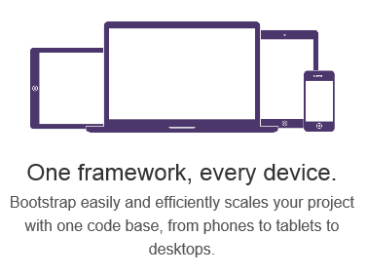
Responsive Layout

Slide 18
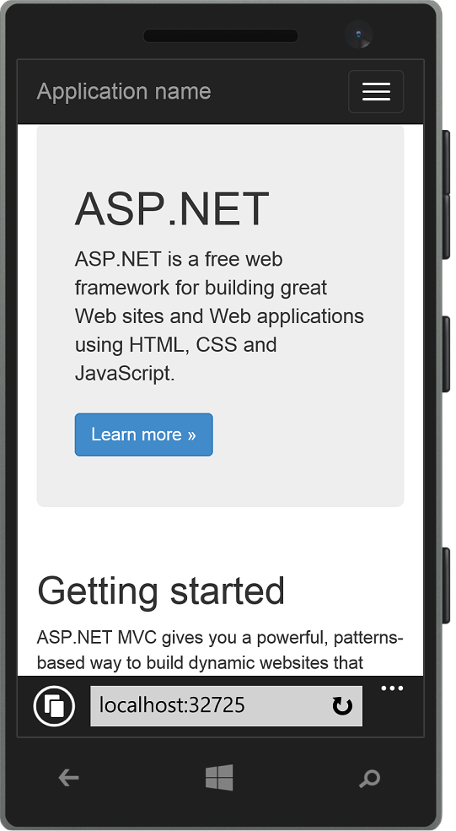
Responsive Layout

Slide 19
Bootstrap - Responsive
Notes:
Show page responding to screen width changes
Show page in mobile browser
Emphasize that this is just HTML and CSS – no server or JS code

Slide 20
Grid System

Slide 21
Grid system
 | Extra small devices Phones (<768px) | Small devices Tablets (≥768px) | Medium devices Desktops (≥992px) | Large devices Desktops (≥1200px)
Grid behavior | Horizontal at all times | Collapsed to start, horizontal above breakpoints
Container width | None (auto) | 750px | 970px | 1170px
Class prefix | .col-xs- | .col-sm- | .col-md- | .col-lg-
# of columns | 12
Column width | Auto | 60px | 78px | 95px
Gutter width | 30px (15px on each side of a column)

Slide 22
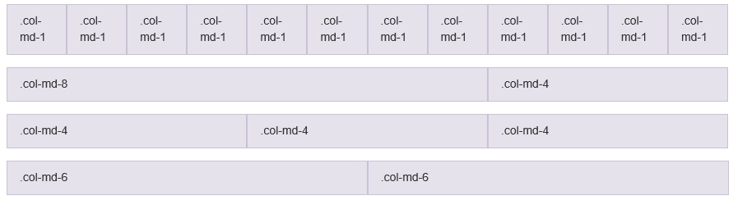
Grid system

Slide 23
Bootstrap - Grid
Notes:
Christopher - Grid

Slide 24
Components

Slide 25





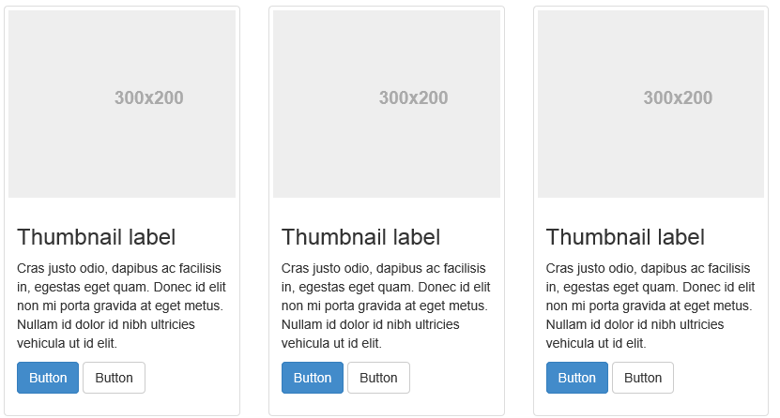
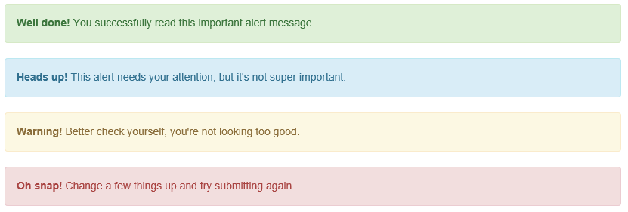
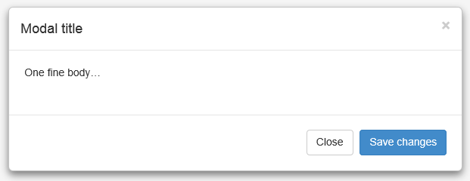
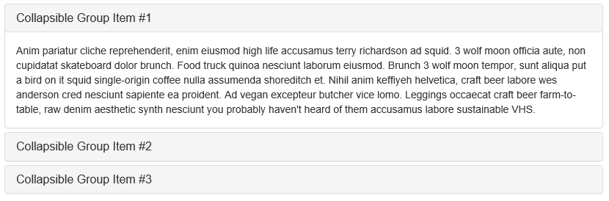
Components

Slide 26
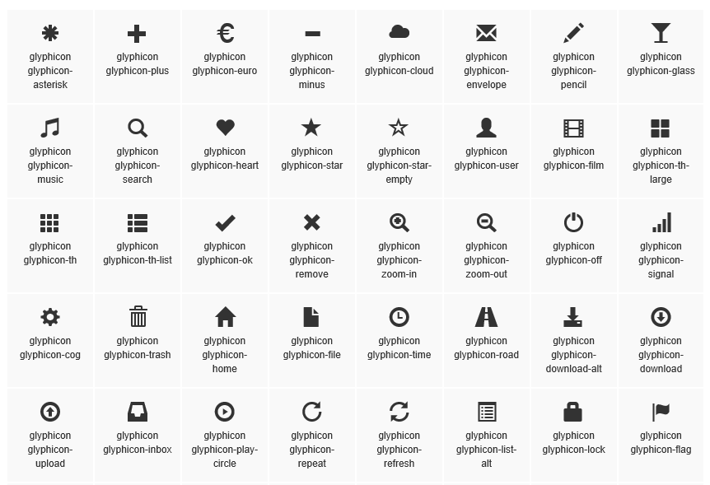
Glyphicons

Slide 27
Bootstrap - Components
Notes:
Grab HTML snippets from Bootstrap site, paste into ASP.NET site
Use VS Snippets

Slide 28
Visual Studio support

Slide 29
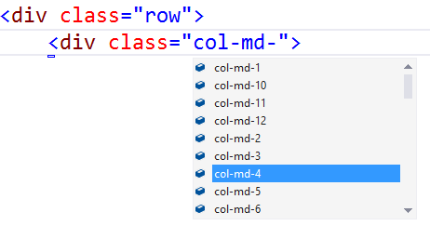
Visual Studio – Class IntelliSense

Slide 30
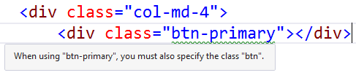
Visual Studio – Missing Class Detection

Slide 31
Bootstrap – Visual Studio Support

